Slide 1
Employee Onboarding Success
Leigh McHargue
Director of Employer Resources
Notes:
Hello, my name is Leigh McHargue and I’m the Director of Employer Resources for The Arc Central Chesapeake Region. Today I will be walking you though the onboarding process. I ask that everyone remain muted throughout the presentation. Please feel free to enter your questions in the chat, and they will be answered at the end.

Slide 2
Content & Goals for this Session
New Hire Forms
Common Issues to Avoid
Communication
Background Checks
Clearance
Location of Forms
Notes:
Today I will be reviewing the employee onboarding process, the required documentation, common errors to avoid, our communication process, the clearance process, and the location of helpful forms and resources for your success.

Slide 3
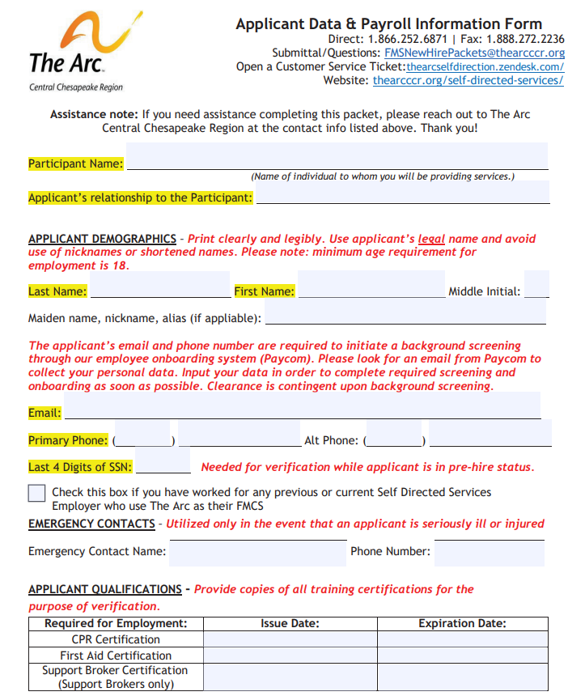
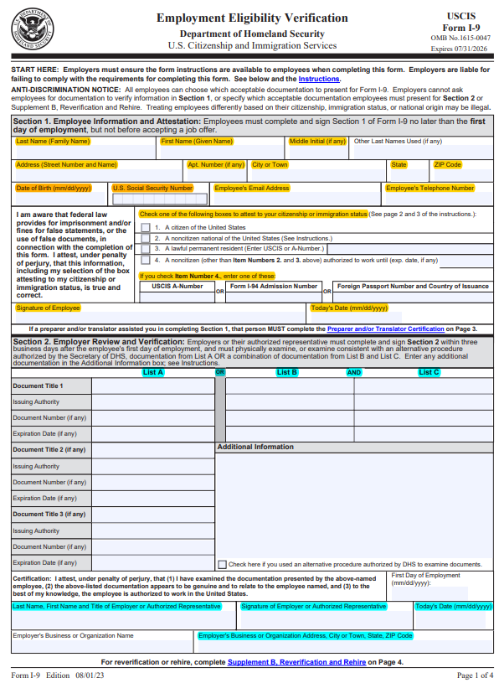
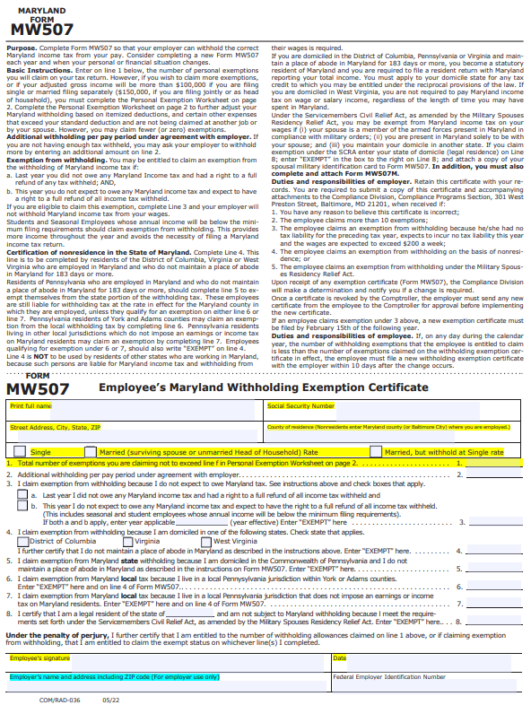
New Hire Forms
Applicant Data & Payroll Form
I-9 Form
W-4 Form
MW507 Form
Paycom Direct Deposit Form
Employee Agreement Form
Special Tax Exemption Form
Notes:
These are the essential documents in the New Hire Packet that I’m going to review with you first. All of these forms must be completed and submitted for your New Hire Packet to be considered complete. All of these forms are available on The Arc’s website, the link to which is at the end of this presentation.

Slide 4
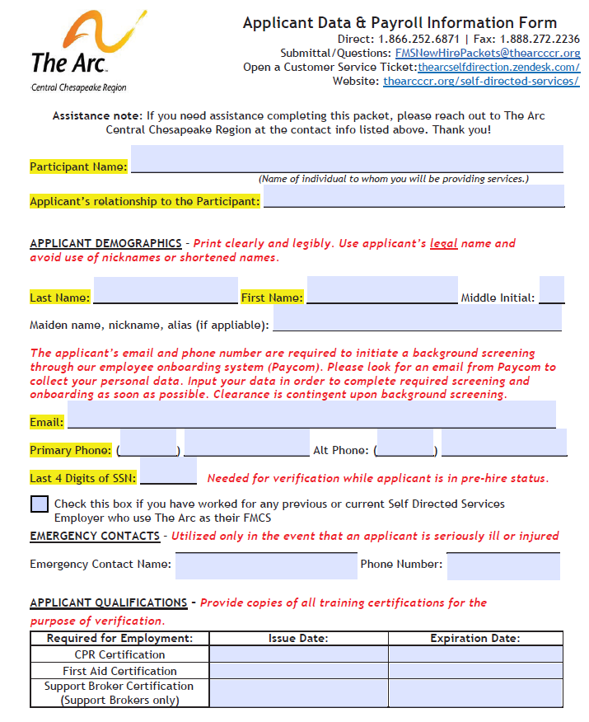
Applicant Data & Payroll Form (Page 1)
Identifies Participant Employer and Applicant
Initiates criminal background check process
Emergency contact information
CPR/First Aid Training Certifications
In-person/hybrid training is mandatory.
Virtual training is not acceptable.
Notes:
The ADPF is the first form in the new hire packet. Its use is similar to that of a job application. Page 1 identifies the participant employer, applicant, and certification dates. This form is also used to initiate the criminal background check process. It’s important to note that copies of CPR, First Aid and Support Broker certifications are required to be submitted with the new hire packet. Both CPR and First Aid training must be completed with an in-person skills component to be considered compliant. Virtual skills training is NOT acceptable for CPR or for First Aid.

Slide 5
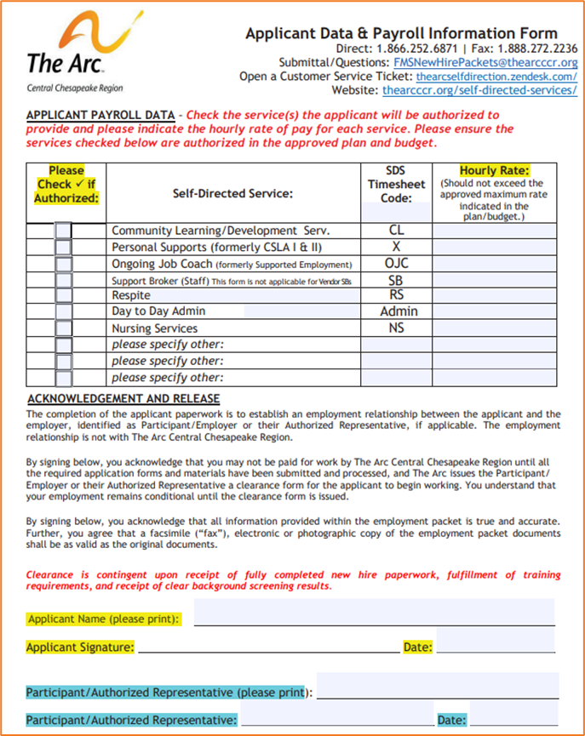
Applicant Data & Payroll Form (Page 2)
Identifies service codes & pay rates
Signed by applicant and Participant
Common Errors to Avoid:
Incomplete full legal name (nicknames)
Missing legal guardian relationship
Illegible email address, service codes, and rates
Rates do not match budget
Rates/service codes do not match Family as Staff (FAS) form
Not including Holiday/PTO service codes
Notes:
Page 2 of the ADPF identifies service codes and pay rates. Common errors include missing / incomplete full legal names, missing signatures, illegible email addresses, and unclear service codes / rates. Requested rates must be included in the budget and can not exceed approved amounts. Rates and service codes must also match the Family as Staff form. We recommend including service codes such as holidays and paid time off – at the time of application.

Slide 6
I-9 Form
Applicant completes Section 1
Participant completes Section 2
It is not mandatory to submit copies of ID, but the Participant must set a standard procedure for all applicants
Must be signed and dated by both the applicant and the Participant
Notes:
Section 1 of the I-9 form is to be completed, signed and dated by the applicant. Section 2 is to be completed by the participant employer. It is not mandatory to submit copies of applicant identification, however a standard procedure must be established by the participant employer to ensure consistent business practices. What does this mean? If you require copies of identification for one applicant, you must require it for all applicants. Page 1 must be signed and dated by both the applicant and participant employer. Please leave the First Day of Employment blank.. This date will be established once clearance to start working is submitted to the team.

Slide 7
I-9 Form
Common Errors to Avoid in Section 1
Missing applicant SSN
Missing applicant DOB
Incomplete applicant address
Unchecked citizenship/immigration status box
Notes:
Common errors in section 1 to avoid include…

Slide 8
I-9 Form
Common Errors to Avoid in Section 2
Incomplete/inaccurate documentation in List A or B and C
Employer should use page 2 of the I-9 as a guide to acceptable documentation
First Day of Employment must be BLANK
If legal guardian, notate relationship on all signed documents
Expired I-9 form —current form expires 7/31/26
Notes:
Common errors in section 2 to avoid include…

Slide 9
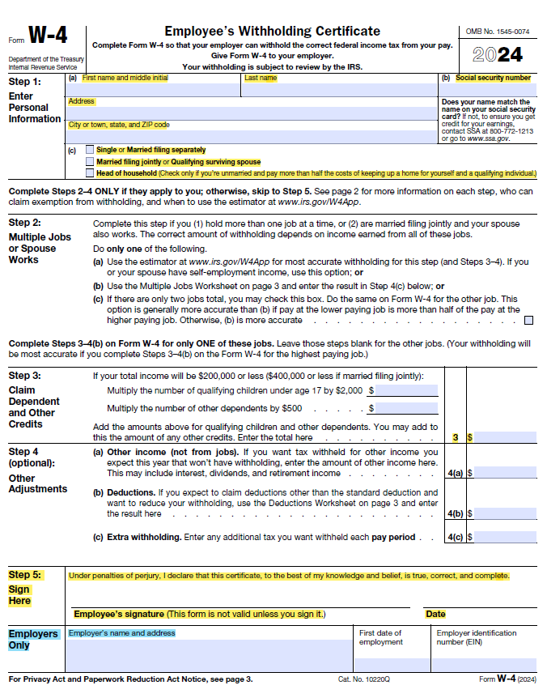
W-4 Form
Applicant completes Steps 1-4 as applicable, then signs and dates
Participant completes the blue highlighted section at the bottom of the form.
Notes:
To successfully complete the W-4 form, the applicant is responsible for entering their full legal name, SSN, complete home address, and selecting their marital status. If an applicant wishes to claim dependents, the instructions direct them to enter $2,000 per child under age 17 and $500 for each adult dependent. Both the applicant and participant employer must complete the bottom of the form. Please note: We are not Tax Advisors and as such we do not provide tax guidance. We recommend that applicants seek guidance from their Tax Advisor if they are unsure how to complete this form.

Slide 10
W-4 Form
Common Errors to Avoid
Incomplete full legal name (nicknames)
Missing SSN
Incomplete address
No marital status selected
Entering a # of dependents instead of a dollar value in Step 3
Entering exempt dollar value AND claiming exempt
Applicants can only choose one of these options!
Expired form —use current year!
Notes:
Common errors to avoid include…

Slide 11
MW507 Form
Applicant completes the top section and questions 1-8 as applicable, then signs and dates
Participant completes the bottom blue section
Notes:
To successfully complete the MW507 form, the applicant is responsible for entering their full legal name, SSN, full street address with city, state, and zip code, and County of residence. If the applicant lives outside of Maryland, they should enter the county in which they are employed. Next, ensure that the applicant has selected their marital status. If the applicant wishes to claim dependents, they will enter that number into line 1. If claiming no dependents, please instruct the applicant to enter zero in line 1. We do not assume zero when left blank. If they wish to claim exempt, they should follow the instructions related to exemption in lines 3 – 8. the applicant must sign and date the bottom of the form. Once again, please note: We are not Tax Advisors and as such we do not provide tax guidance. We recommend that applicants seek guidance from their Tax Advisor if they are unsure how to complete this form.

Slide 12
MW507 Form
Common Errors to Avoid
Incomplete full legal name (nicknames)
Missing SSN
Incomplete address
Missing county of residence
No marital status selected
Entering a # of dependents in line 1 AND claiming exempt
Applicants can only choose one of these options!
Expired form – use the version posted on our website!
Notes:
Common errors to avoid include…

Slide 13
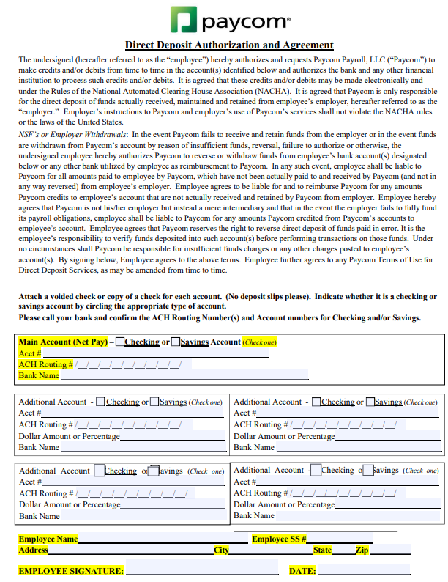
Paycom Direct Deposit Form
All applicants must complete this form
If direct deposit is waived, applicants should complete the bottom portion, sign, date, and indicate “waive” on the form
Multiple direct deposit accounts are acceptable
Direct deposit is HIGHLY recommended!
Notes:
The Paycom direct deposit form must be completed by all applicants, including those who wish to waive direct deposit. If an applicant wishes to waive, please instruct them to write “waive” on the form, then fully complete, sign and date the yellow highlighted sections at the bottom of the form.

Slide 14
Paycom Direct Deposit Form
Common Errors to Avoid
Not selecting “Checking” or “Savings”
Account #/Routing # on incorrect lines
Missing Bank Name
Illegible account information
Missing signature/date
Notes:
Common errors to avoid include…

Slide 15
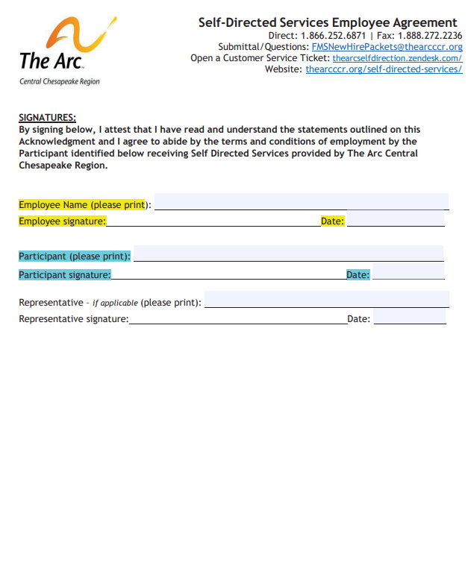
Employee Agreement Form (Page 3)
Must be signed/dated by applicant
Must be signed/dated by Participant or legal guardian as documented in our records
Notes:
The Employee Agreement is a legally binding contract between the participant employer and the applicant. After reading the agreement, the applicant must sign and date the form in addition to printing their full legal name. The participant employer must sign and date as well, in addition to printing their full legal name.

Slide 16
Employee Agreement Form (Page 3)
Common Errors to Avoid
No documentation of legal guardianship
Applicant cannot sign as both applicant and legal guardian/representative
Incomplete full legal name (nicknames)
If legal guardian, notate relationship on all signed documents
Notes:
Common errors to avoid… We must have documentation of legal guardianship on file. A common question we are asked is if a parent who is the legal guardian who is applying to work for their child can sign their own new hire paperwork on behalf of the participant employer. The answer is no. We encourage the participant to sign if they are able, however if they are not, the participant’s name can be typed, a signature stamp can be used, or the participant’s name can be printed as signature. No abbreviated or nicknames are acceptable. If a legal guardian is signing an applicant’s paperwork on behalf of the participant, please notate your relationship clearly on all paperwork.

Slide 17
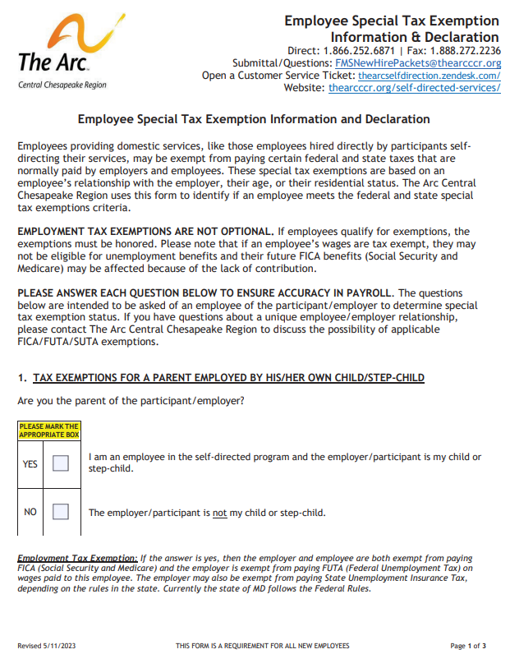
Special Tax Exemption Form (Page 1)
Required for all applicants
Question 1 is for parents and step-parents
Benefits – employment tax exemption
Medicare Exempt
Social Security Exempt
Notes:
The Special Tax Exemption form must be completed by all applicants. Page 1 is related to parents and step-parents. If the applicant is a parent or step-parent, they must indicate yes. Choosing yes will exempt the applicant from paying Social Security and Medicare taxes. This exemption cannot be waived.

Slide 18
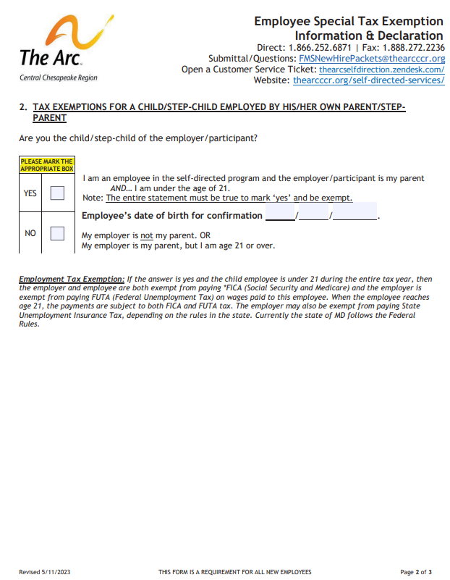
Special Tax Exemption Form (Page 2)
Question 2 is for children/step-children of the participant who are under age 21
Benefits – employment tax exempt until age 21
Medicare Exempt
Social Security Exempt
Notes:
Page 2 of the Special Tax Exemption form is related to children and step-children. If the applicant is a child or step-child under the age of 21, they must indicate yes. Choosing yes will exempt the applicant from paying Social Security and Medicare taxes until they turn 21 years old. This exemption cannot be waived.

Slide 19
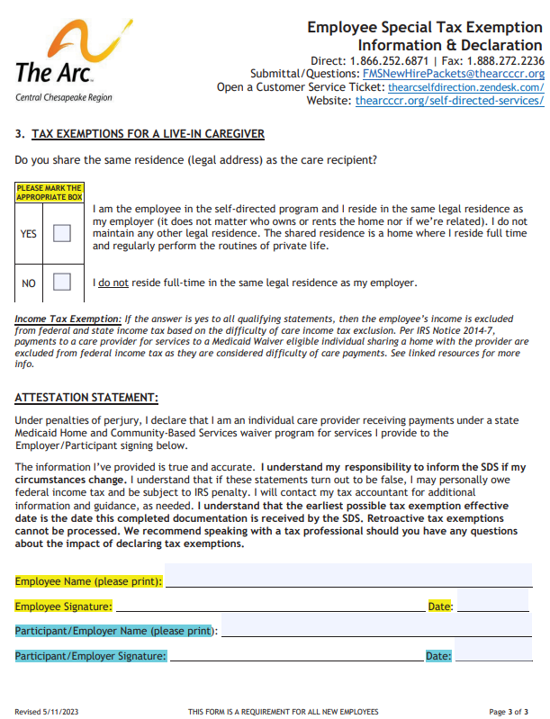
Special Tax Exemption Form (Page 3)
Question 3 is for applicants whose full-time legal residential address is shared with the Participant, regardless of relationship to the Participant
Benefits – Difficulty of Care income tax exemption
Federal Tax Exempt
State Tax Exempt
Notes:
Page 3 of the Special Tax Exemption form is related to all caregivers who share the same legal residence with a participant full time, regardless of relationship to the participant. Choosing yes will exempt the applicant from paying State and Federal taxes. This exemption can be waived. If the exemption applies, but the applicant chooses to waive, instruct them to select “yes” and write “waive” on the form, then sign, date and print their full legal name. The participant employer must also sign, date, and print their full legal name.

Slide 20
Special Tax Exemption Form
Common Errors to Avoid on All Pages
Unanswered questions
Missing applicant signature/date
Missing Participant signature/date
Incomplete full legal name (nicknames)
Applicant must not sign as applicant and legal guardian/representative
If legal guardian, notate relationship on all signed documents
Incorrect version of form – use the form on our website!
Notes:
Common errors to avoid include…

Slide 21
“How can we expedite the onboarding experience?” Communication!

Slide 22
Communication
A team representative is assigned to each individual New Hire Packet.
Representatives email the team to request updated or additional documentation and information as applicable.
If the team feels additional assistance is needed, we encourage them to request a virtual meeting to review instructions for completion of the paperwork.
New Participants are encouraged to request a one-time in-person onboarding meeting for their first applicant.
Notes:
A Specialist is assigned to each individual new hire packet. They will provide consistent communication to the participant and their team throughout the entire onboarding process. So, there is only one contact throughout the entire onboarding process. If the team feels that additional assistance is needed, we encourage you to request a Teams or Zoom meeting to review instructions for completion of the paperwork virtually. New participants are encouraged to schedule a one-time in-person onboarding meeting for onboarding their first applicant.

Slide 23
Criminal Background Check Process
Criminal background checks must be run on all applicants.
Upon receipt of the New Hire Packet, an invitation is sent through Paycom to the applicant.
We will also email the team to remind them that the applicant has 6 days to respond before the link expires.
Completing the background check quickly expedites this portion of onboarding.
Notes:
Upon receipt of the new hire packet, we use the Applicant Data & Payroll form to initiate the criminal background process. A link is sent to the applicant from Paycom, the company we use when processing payroll. The link expires after 6 days, so it is imperative that the applicant completes and submits the requested information as soon as possible. We email the participant and their team when the link has been sent to the applicant. Reminding the applicant to check their email and complete the link will expedite the onboarding process.

Slide 24
CPS Background Check Process
Applicants applying to support a Participant who is a minor must complete and submit a CPS background check application in addition to the routine criminal background check.
The application and instructions are located on our website.
Please note that the form must be typed and notarized. Submit to FMSEmployeeRelations@thearcccr.org.
Results can take up to 6 weeks to receive.
Notes:
Applicants who apply to work for a minor participant must complete and submit a SEPARATE CPS background application in addition to the routine criminal background.. The application and instructions are located on our website. The information must be typed and the application must be notarized. Results can take up to 6 weeks to receive. It’s essential to start this process as early as possible.

Slide 25
Clearance
Applicants are not permitted to start working until a written clearance authorization form is received by the team via email with an official start date.
One team representative will guide the Participant and their team throughout the onboarding process.
We encourage questions and aim to work collaboratively to ensure a seamless onboarding experience.
Notes:
Once all new hire paperwork is complete, training certifications are confirmed, and services are started, a written clearance authorization form is issued to the participant and their team by email. This clearance form includes the official date the employee can start working. Please note that applicants are not permitted to start working until the clearance authorization form has been received by the participant and their team; once received, the employee can not log hours worked prior to the official start date provided in the clearance form. We encourage questions and aim to work collaboratively to ensure a seamless onboarding experience.

Slide 26
Location of Forms
All forms and resources are conveniently located on our website: www.thearcccr.org/fms-forms-resources/
The complete fillable New Hire Packet is available on our website: www.thearcccr.org/wp-content/uploads/2023/08/SDS-New-Hire-Packet-Highlighted-Guide-8-02-23.pdf
All New Hire Packet paperwork should be submitted via email to FMSNewHirePackets@thearcccr.org
Turnaround time for processing is 4-6 days, depending on the length of time it takes to receive criminal background results and fully completed New Hire Packet documentation.
Notes:
Helpful tools, resources, and forms are located on our website at www.thearccr.org. I have also included a direct link to the new hire packet as well as the email address to submit all new hire paperwork to. Turnaround time for processing is 4-6 days, depending upon the length of time it takes to receive the criminal background results and fully completed new hire documents.

Slide 27
Questions?

