Slide 1
Budget Modifications & Revisions
Michelle Nicholas
Budget Manager

Slide 2

Today We’ll Be Reviewing:
When and why to complete a budget modification
Tips for completing a budget modification
When to complete a Revised PCP Budget Sheet
Tips for completing a Revised PCP Budget Sheet

Slide 3

Budget Sheets
Required for every approved Initial, Annual, or Revised PCP in LTSS
Budget Sheets must match the PCP
Budget Sheets are reviewed by the Budget Review Team
Budget Sheets are submitted to SDSParticipants@fello.org or uploaded to LTSS Client Attachments for review.

Slide 4
Revised PCP Budget Sheet vs. Budget Modification
What’s the difference?
Budget Modification | Revised PCP Budget Sheet
Used to reallocate funding between previously approved service lines Budget modifications are not visible in LTSS Budget Modifications are submitted to SDSParticipants@fello.org | Required when the Detailed Service Authorization needs an update to one or more services

Slide 5
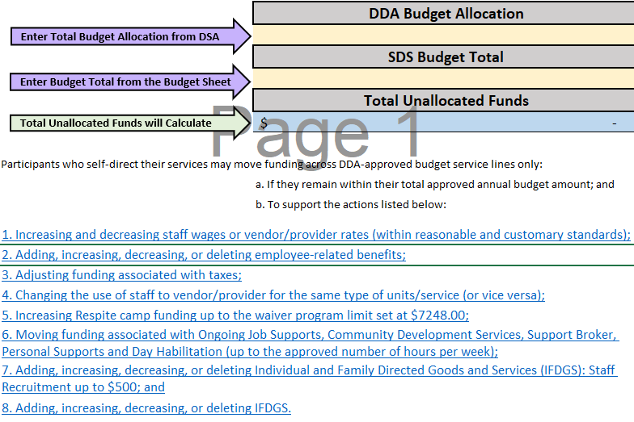
Budget Modification Guidelines
This information can be found on the Modification Cover of the Budget Modification Form

Slide 6
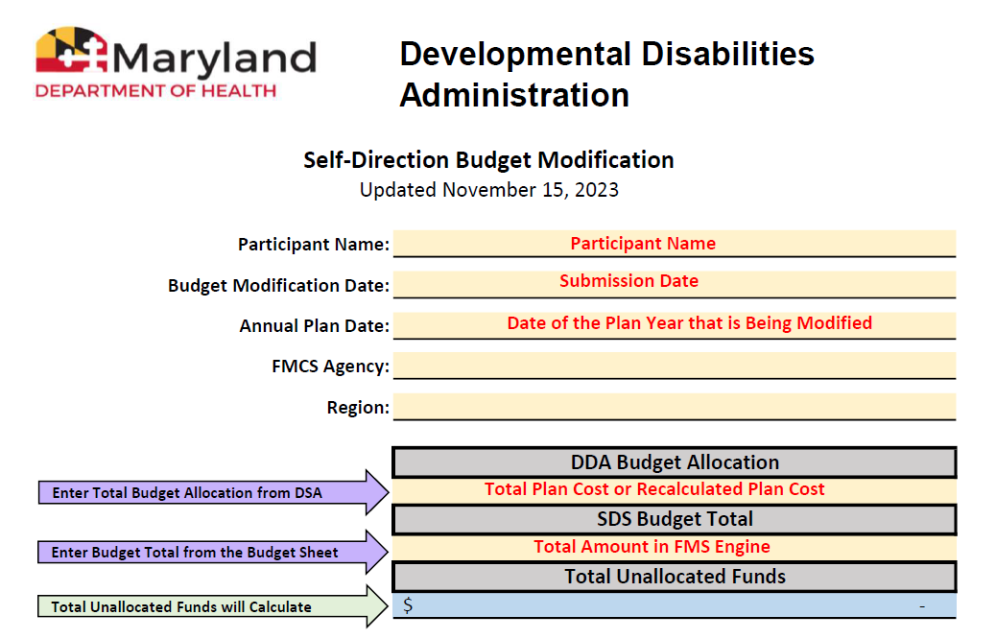
Completing the Modification

Slide 7
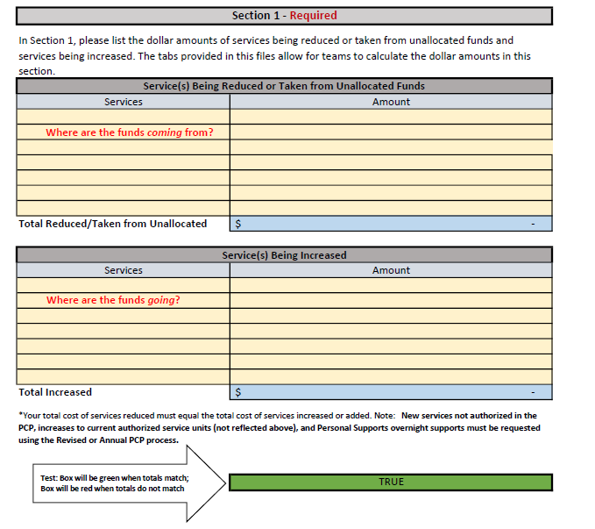
Completing the Modification

Slide 8
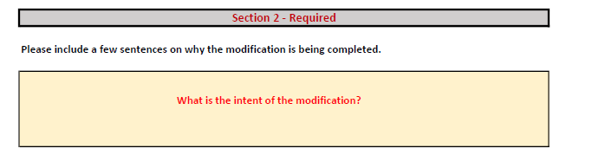
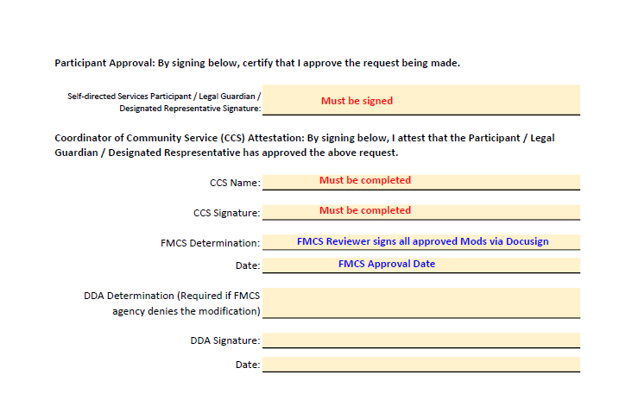
Completing the Modification

Slide 9
Allowed Actions
Increasing and decreasing employee wages or vendor/provider rates (within reasonable and customary standards)
Current rate and intended rate are to be listed in Section 2.
Adding, increasing, decreasing, or deleting employee-related benefits
Approved Wage Exception Forms are required for Holiday Pay Differential Rates.
Adjusting funding associated with taxes
This is uncommon.
Changing the use of employee to vendor/provider for the same type of
units/service (or vice versa)
Occasionally Unallocated Funds or another source of funding will be needed to adjust for Employee/Vendor rates.

Slide 10
More Allowed Actions
Increasing Respite camp funding to the waiver program limit set at $7,248.
Moving funding associated with Ongoing Job Supports, Community Development Services, Support Broker, Personal Supports, and Day Habilitation (up to the approved number of hours per week)
Adding, increasing, decreasing, or deleting Individual Family Directed Goods and Services (IFDGS): Staff Recruitment up to $500
Adding, increasing, decreasing, or deleting IFDGS allowable goods and services
The IFDGS Request Form must be completed and approved prior to payment of IFDGS items

Slide 11


Notes
Units in any service cannot be increased.
Cannot add funds due to overtime or over-utilization – this is considered increasing units
A modification cannot be performed on a plan that is in LTSS auto-extend
A modification cannot be made to a budget that has not been approved by the FMCS
Wage Exception Forms are required for wages over DDA’s Reasonable and Customary guidelines, including Holiday Pay Differential

Slide 12

When to Revise the PCP
Adding a new service
Removing a service
Increasing/decreasing service units
Increasing/decreasing service funding amounts for Upper Pay Limit Services

Slide 13

Best Practices
The Revised PCP Budget Sheets should be identical to the previous budget sheets except for the following changes:
Effective Date
DDA Budget Allocation
Service Changes authorized in the PCP
The only time the budget sheets would not be identical to the previously approved budget sheets is if:
Budget Mods were completed between PCPs
Wage/rate changes

Slide 14
Common Errors
When the Effective Date and Annual Plan Date are not the same, the budget sheet will automatically calculate the number of months and weeks remaining in the plan year.
A common error is prorated budget sheets.
Services that were not changed in the Revised PCP should not be prorated, as the budget will be inaccurate due to past expenses/usage not being reflected.
Not including Employee Benefits that have usages.
PTO, Holiday Pay Differential, Health Benefits, Training Costs, Training Wages, Mileage, Staff Transportation/Travel Reimbursement
Omitting previously processed budget modifications.

Slide 15
Questions?

